Slide 1
Python Installation and Tutorial
2024.02.29.

Slide 2
Python: Installation

Slide 3
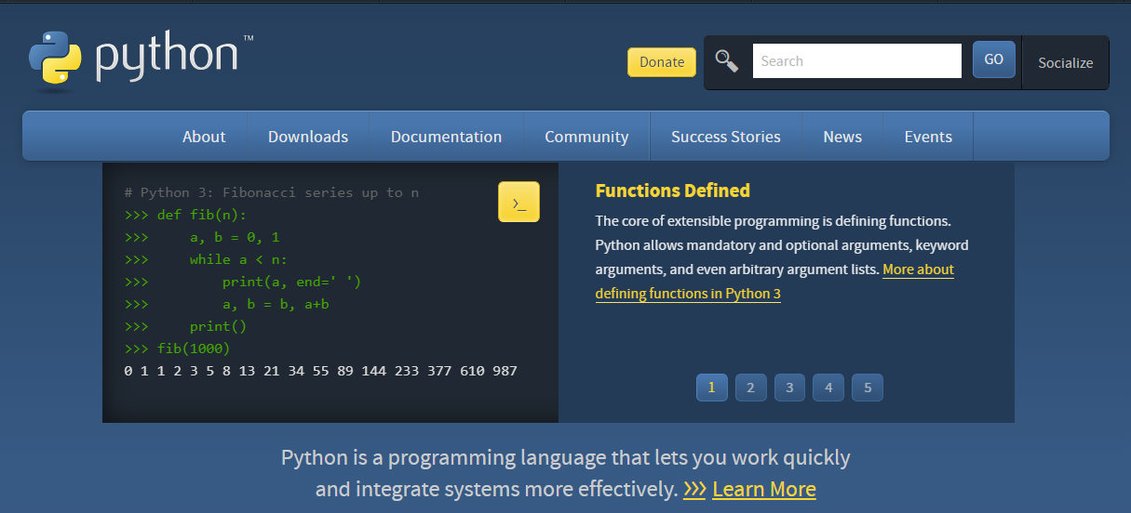
Installation
Python
Visit https://www.python.org/downloads/ and download Python installation file depending on your OS (Windows, Linux/UNIX, Mac OS X) and which version you want to install.
I recommend you download Python version >= 3.8 for compatibility.
This slide assumes that OS is Windows.
There are two stable versions of python: 3.X, 2.X
Two versions are a little bit different, but different features do not matter in this course.

Slide 4
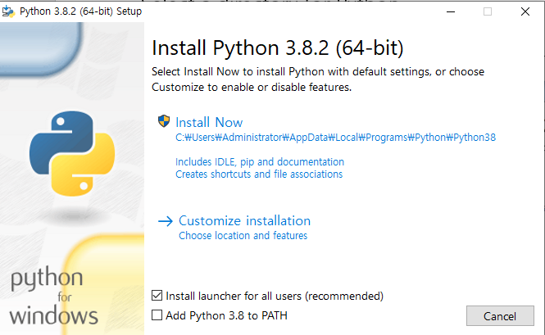
Installation
Select a directory for Python
Set up an install path including version (red box)
When you install different versions of Python simultaneously, it is good choice

Slide 5
Installation
Why Python?
Python is a language with a low barrier to entry compared to other programming languages.
It is highly readable, easy to maintain, and even free.
Many useful and available libraries
Due to its strengths, many developers have used Python and have left useful built-in functions. Following developers can utilize these built-in functions to make further improvements.
As a result, there are immensely many functionalities already developed and distributed. These positive feedback loops make Python as a standard programming language in data analysis.

Slide 6
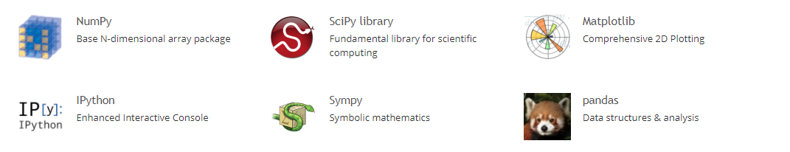
Installation packages
SciPy
Python-based ecosystem of open-source software for mathematics, science, and engineering
http://www.scipy.org/
[Core packages]

Slide 7
Installation packages
Scikit-learn
Free software machine learning library for the Python programming language
Simple and efficient tools for predictive data analysis
Built on Numpy, SciPy, and Matplotlib
https://scikit-learn.org/stable/index.html

Slide 8
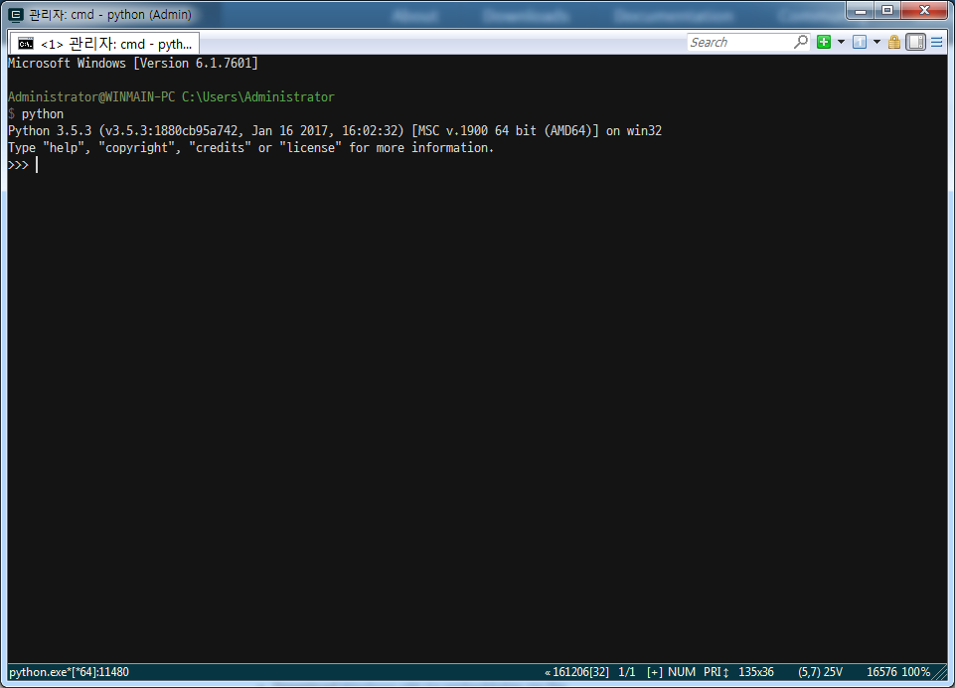
Start Python
To start Python, just type “python” at cmd (terminal in Mac) prompt
Python is script language

Slide 9
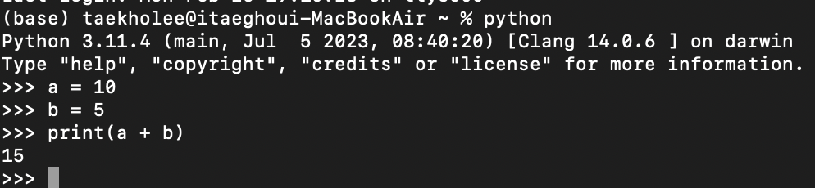
Start Python
Interact with the computer using python in a Shell environment.
Developing python programs and analyze data is too inconvenient.
In the shell environment, we can only execute simple commands, and if we want to develop something complex, we need to organize and manage long long code.

Slide 10
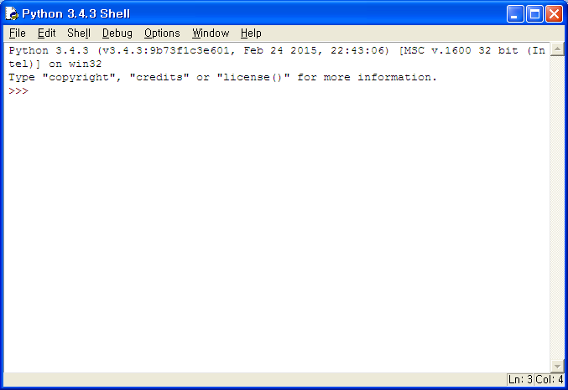
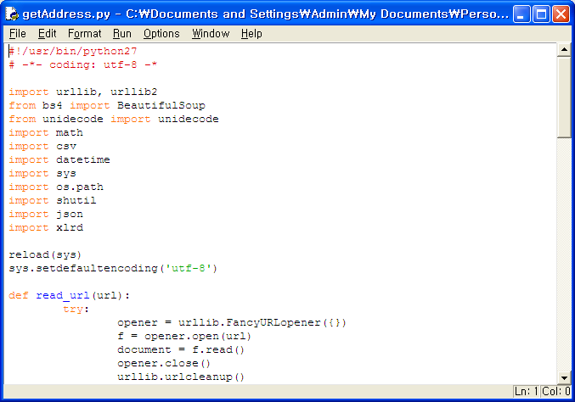
Python editors
There are many Python IDEs (Integrated Development Environment)
If we want to use better IDE than the shell environment,
https://www.simplilearn.com/tutorials/python-tutorial/python-ide
There is also default IDE installed with Python, but others are generally recommended.

Slide 11
Python editors
IDE recommendation (opinion)
Visual studio code
High recognition globally, supports multiple programming languages including Python. Strong extension functionality allows you to be equipped additional features.
Not a dedicated Python editor, which might be inconvenient for beginners unfamiliar with Python and computers.
Pycharm
Optimized for Python, beloved by professional Python developers. Offers smart features and a variety of conveniences like auto-completion and syntax checking.
To utilize all features, the paid version is necessary (education license is free for students). Recommended for those who have developed an interest and proficiency in writing Python code.
Jupyter notebook (interactive)
Highly recommended for beginners unsure about which editors suits them. Allows code execution in block units. Similar user interface to Google Colab, which does not require installation to use Python, making it highly accessible.
Not recommended for intermediate or expert of Python. (They can already choose and use proper editors, including Jupyter notebook, whenever they do some work.)

Slide 12
Easy installation
The easiest way to install the packages of Scipy stack is to download one of these Python distributions, which includes all the key packages.
Anaconda: A free distribution for the Scipy stack. Support Linux, Windows, and Mac.
Enthought Canopy: The free and commercial versions include the core Scipy stack packages. Support Linux, Windows, and Mac.
Python(x,y): A free distribution including the Scipy stack, based around the Spyder IDE. Windows only.
WinPython: A free distribution including the Scipy stack. Windows only.
Pyzo: A free distribution based on Anaconda and the IEP interactive development environment. Support Linux, Windows, and Mac.

Slide 13
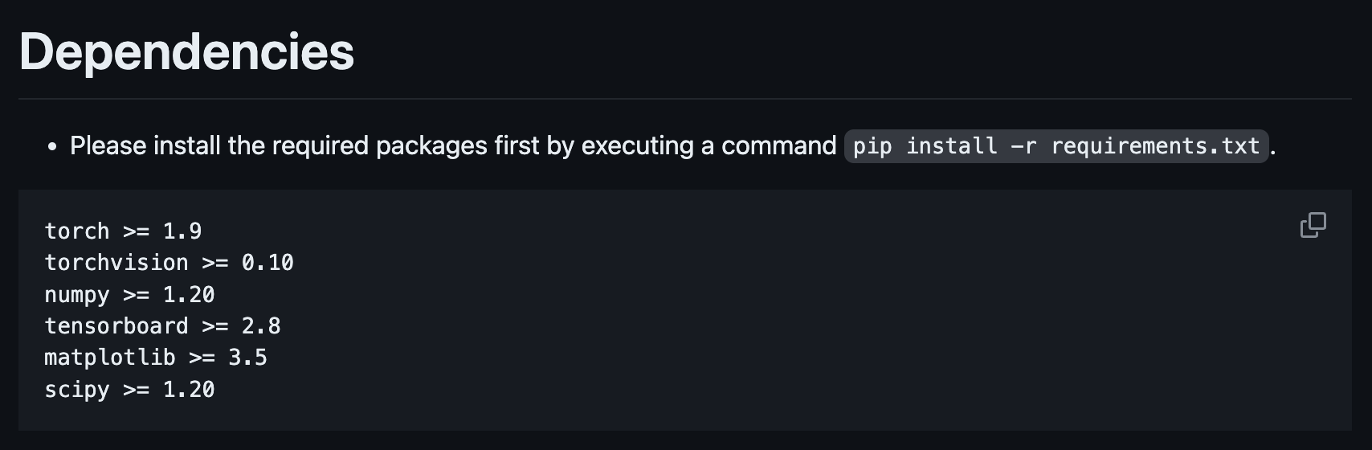
Easy installation
In my opinion, I recommend installing Anaconda especially if you are a beginner in using Python.
What is Conda?
A tool for managing packages, dependencies, and environments for languages (including Python).
What does it mean to manage environments?
There are a lot of different versions of Python and other libraries.
When you are involved in multiple projects with different dependencies simultaneously, some functions in one project may not work properly in another project or may even raise errors, although most functions remain stable and unchanged.

Slide 14
Easy installation
Anaconda vs. Miniconda
Anaconda
Includes over 1500 data analysis packages.
Can be used for commercial purposes within companies.
The most comprehensive distribution of Python.
Representative tools: pandas, numpy, scipy, scikit-learn, matplotlib, and Jupyter notebook.
Miniconda
Includes only conda, Python, pip, zlib, and a few other useful or dependent packages.
Contains minimal requirements and allows installation of desired packages as needed.
To summarize, Anaconda is good for beginners and convenient as it automatically installs many scientific packages at once, but installing it requires time and disk space. On the other hand, Miniconda does not require the installation of all additional packages, allowing for quick installations and access to Python.

Slide 15
Easy installation
Two common errors in installing Anaconda
System “username” is in Korean.
Basically, we set the installation path of Anaconda to “C:\Users\<Username>\Anaconda3” as default.
When <Username> is in Korean, the error sometimes occurs. Make the whole installation path English.
Python is already installed.
If the version of already installed Python is included in Anaconda that we want to install, errors can occur when we install it or even after the installation ends.
Remove already installed Pythons and their folders and then install Anaconda again.

Slide 16
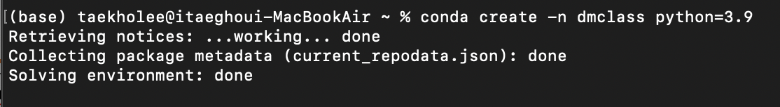
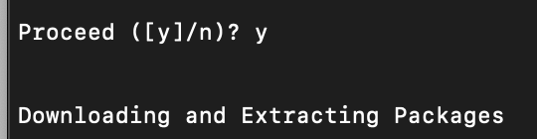
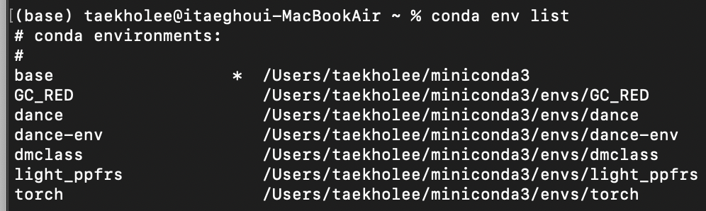
Run Jupyter notebook
Conda implementation
conda create –n “env_name” python=“version”
conda env list

Slide 17
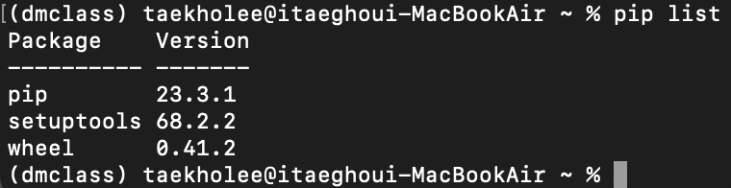
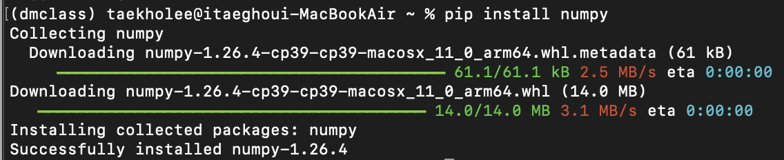
Run Jupyter notebook
Conda implementation
conda activate ”env_name”
We can identify here (“env_name”) as activated environment.
Each environment contains independent python and library versions.
pip list
We can identify library versions in the activated environment.
pip install “library_name”

Slide 18
Run Jupyter notebook
Jupyter notebook
A convenient web-based platform that operates on the web, similar to an internet browser (other editors are based on their own programs).
This advantage dominates the disadvantages for beginners.
The disadvantages are as follows:
It is difficult to apply in actual business practices since it contains meta-information related to blocks.
People who use Jupyter notebook should convert code files after the development ended (very annoying task as the project becomes larger)

Slide 19
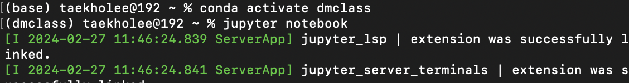
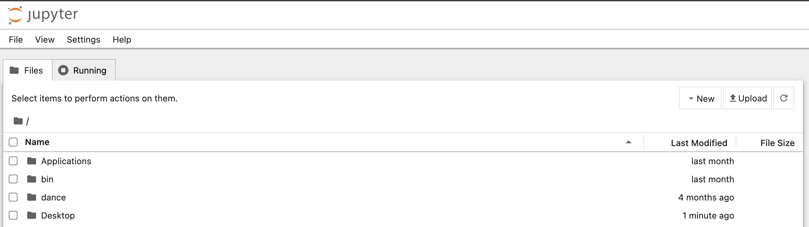
Run Jupyter notebook
Activate the environment that we created and installed necessary packages and then type ”jupyter notebook”.
You can see the screen showing like this.

Slide 20
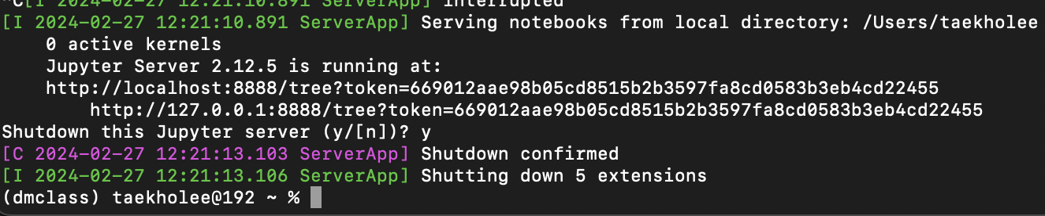
Run Jupyter notebook
Now you are ready to use Jupyter notebook and Python.
How to quit
Even though you exit jupyter notebook web-browser, it keeps working. To stop it, you need to press “ctrl + c” in your terminal (cmd).
Input ”y” if requested.
Set working directory
Use an additional argument as “jupyter notebook --notebook-dir=<path>”. (your path instead of <path>)
For the <path>, you must use “absolute path” (may starts with “C:/ or D:/”) in your computer.

Slide 21
Python: Short Tutorial

Slide 22
Variable types
List
A list contains items separated by commas and encoded within square brackets ([])
list = [ 'abcd', 786 , 2.23, 'john', 70.2 ]
tinylist = [123, 'john']
print list # Prints complete list
print list[0] # Prints first element of the list
print list[1:3] # Prints elements starting from 2nd till 3rd
print list[2:] # Prints elements starting from 3rd element
print tinylist * 2 # Prints list two times
print list + tinylist # Prints concatenated lists

Slide 23
Variable types
Tuple
A tuple consists of a number of values separated by commas. Unlike lists, however, tuples are enclosed within parentheses.
The main differences between lists and tuples are
Lists are enclosed in brackets ( [] ) and their elements and size can be changed.
Tuples are enclosed in parentheses ( () ) and cannot be updated (read-only)
tuple = ( 'abcd', 786 , 2.23, 'john', 70.2 )
tinytuple = (123, 'john')
print tuple # Prints complete list
print tuple[0] # Prints first element of the list
print tuple[1:3] # Prints elements starting from 2nd till 3rd
print tuple[2:] # Prints elements starting from 3rd element
print tinytuple * 2 # Prints list two times
print tuple + tinytuple # Prints concatenated lists

Slide 24
Variable types
Dictionary
They work like associative arrays or hashes found in Perl and consists of key-value pairs.
Dictionaries are enclosed by curly brackets ({}) and values can be assigned and accessed using square braces ([])
dict = {}
dict['one'] = "This is one"
dict[2] = "This is two"
tinydict = {'name': 'john','code':6734, 'dept': 'sales'}
print dict['one'] # Prints value for 'one' key
print dict[2] # Prints value for 2 key
print tinydict # Prints complete dictionary
print tinydict.keys() # Prints all the keys
print tinydict.values() # Prints all the values

Slide 25
Data conversion
Function | Description
int(x [,base]) | Converts x to an integer. base specifies the base if x is a string.
long(x [,base] ) | Converts x to a long integer. base specifies the base if x is a string
float(x) | Converts x to a floating-point number.
complex(real [,imag]) | Creates a complex number.
str(x) | Converts object x to a string representation.
repr(x) | Converts object x to an expression string.
eval(str) | Evaluates a string and returns an object.
tuple(s) | Converts s to a tuple.
list(s) | Converts s to a list.
set(s) | Converts s to a set.
dict(d) | Creates a dictionary. d must be a sequence of (key,value) tuples.
frozenset(s) | Converts s to a frozen set.
chr(x) | Converts an integer to a character.
unichr(x) | Converts an integer to a Unicode character.
ord(x) | Converts a single character to its integer value.
hex(x) | Converts an integer to a hexadecimal string.
oct(x) | Converts an integer to an octal string.

Slide 26
Basic operation
Operator | Description | Example
+ Addition | Adds values on either side of the operator. | a + b = 30
- Subtraction | Subtracts right hand operand from left hand operand. | a – b = -10
* Multiplication | Multiplies values on either side of the operator | a * b = 200
/ Division | Divides left hand operand by right hand operand | b / a = 2
% Modulus | Divides left hand operand by right hand operand and returns remainder | b % a = 0
** Exponent | Performs exponential (power) calculation on operators | a**b =10 to the power 20
// | Floor Division - The division of operands where the result is the quotient in which the digits after the decimal point are removed. | 9//2 = 4 and 9.0//2.0 = 4.0

Slide 27
Logical operators
Operator | Description | Example
== | If the values of two operands are equal, then the condition becomes true. | (a == b) is not true.
!= | If values of two operands are not equal, then condition becomes true.
<> | If values of two operands are not equal, then condition becomes true. | (a <> b) is true. This is similar to != operator.
> | If the value of left operand is greater than the value of right operand, then condition becomes true. | (a > b) is not true.
< | If the value of left operand is less than the value of right operand, then condition becomes true. | (a < b) is true.
>= | If the value of left operand is greater than or equal to the value of right operand, then condition becomes true. | (a >= b) is not true.
<= | If the value of left operand is less than or equal to the value of right operand, then condition becomes true. | (a <= b) is true.

Slide 28
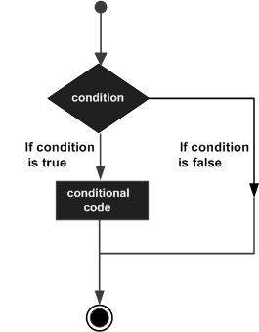
Decision making
If-else
Decision making is anticipation of conditions occurring while execution of the program and specifying actions taken according to the conditions
var = 100
if ( var == 100 ):
print("Value of expression is 100")
else:
print("Value of expression is not 100")

Slide 29
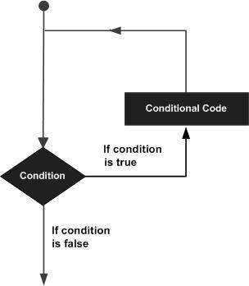
Loop
A loop statement allows us to execute a statement or group of statements multiple times
primes = [2, 3, 5, 7]
for prime in primes:
print(prime)
for x in range(5): # or range(5)
print(x)
count = 0
while count < 5:
print(count)
count += 1 # This is the same as count = count + 1

Slide 30
Loop
Loop control statements change execution from its normal sequence
Control Statement | Description
break statement | Terminates the loop statement and transfers execution to the statement immediately following the loop.
continue statement | Causes the loop to skip the remainder of its body and immediately retest its condition prior to reiterating.
pass statement | The pass statement in Python is used when a statement is required syntactically but you do not want any command or code to execute.
count = 0
while True:
print(count)
count += 1
if count >= 5:
break

Slide 31
List comprehensions
Python supports a concept called “list comprehension” used to constructs lists in a very natural, easy way
>>> A=[x**2 for x in range(10)]
>>> print(A)
[0, 1, 4, 9, 16, 25, 36, 49, 64, 81]
>>> B = [x for x in S if x % 2 == 0]
>>> print(B)
[0, 4, 16, 36, 64]
>>> C = [x+3 for x in A]
>>> print(C)
[3, 4, 7, 12, 19, 28, 39, 52, 67, 84]
>>> D = [x+3 if x%2==0 else x for x in A]
>>> print(D)
[3, 1, 7, 9, 19, 25, 39, 49, 67, 81]

Slide 32
List comprehensions
A = [x**2 for x in range(10)]
range(10) creates list whose elements are from zero to nine
[0, 1, 2, 3, 4, 5, 6, 7, 8, 9]
for x in range(10): loop for elements in range(10)
“x” represents each element in range(10)
x**2 for x in range(10): for every element in range(10), calculate x²
Results are stored in A as a list

Slide 33
Index of Python
Python list
index
0 | 1 | 2 | 3 | 4 | 5 | 6
-7 | -6 | -5 | -4 | -3 | -2 | -1
8 | 7 | 5 | 13 | 75 | 65 | 11
negative index
>>>A=[8,7,5,13,75,65,11]
>>>A[0]
8
>>>A[3]
13
>>>A[-1]
11
>>>A[1:4]
[7,5,13]
>>>A[:3]
[8,7,5]
>>>A[4:]
[75,65,11]

